Slide 1

Secure Replica Allocation in Cloud Storage Systems with Heterogeneous Vulnerabilities
Yun Tian
California State University, Fullerton
Email: ytian@fullerton.edu
Xiao Qin
Auburn University
Yafei Jia
IBM Research - China

Slide 2
Outlines
Introduction
Background
SecRA– A Secure Replica Allocation Scheme
Storage Assurance Model
Evaluation Results
Future Work
Notes:
Highly available cloud storage is often implemented with complex, multi-tiered distributed systems built on top of clusters of commodity servers and disk drives.

Slide 3
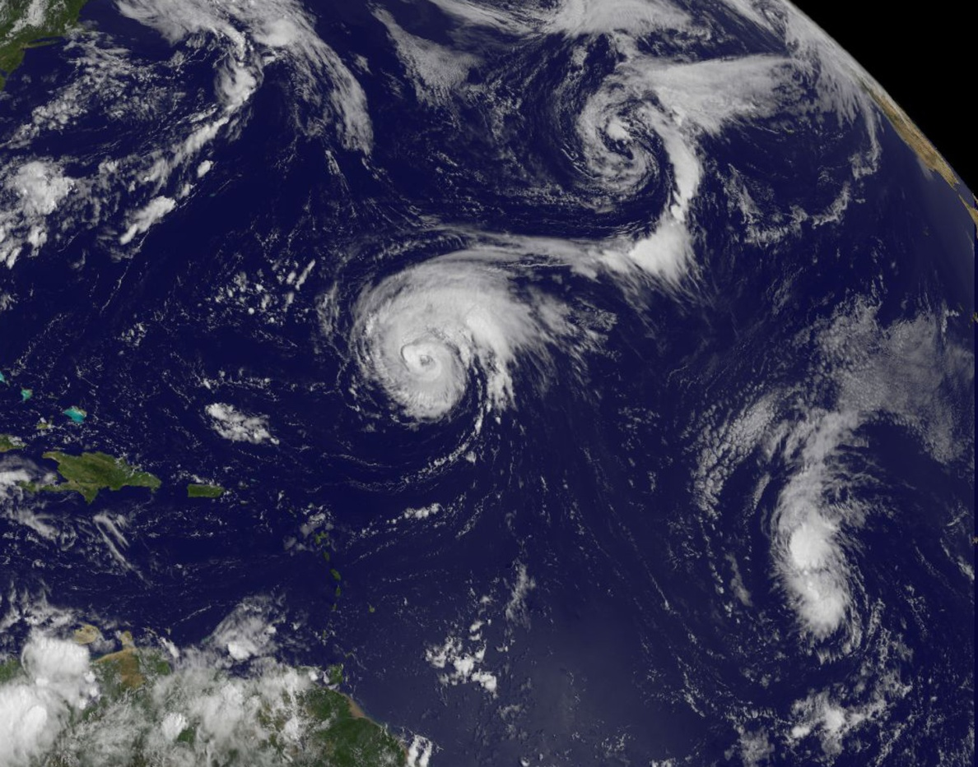
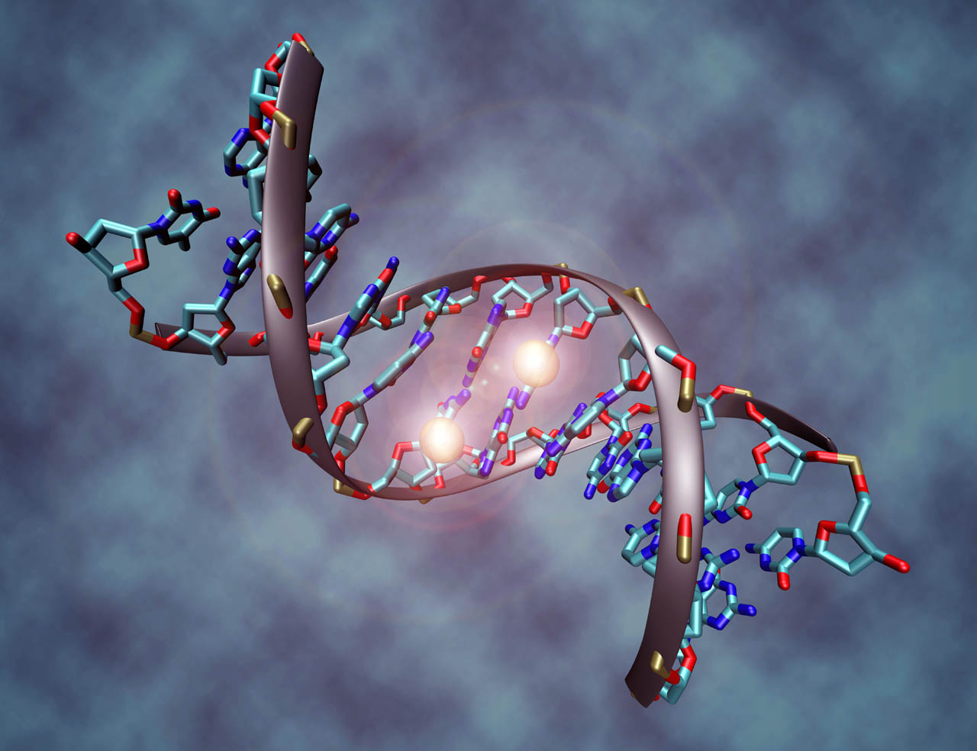


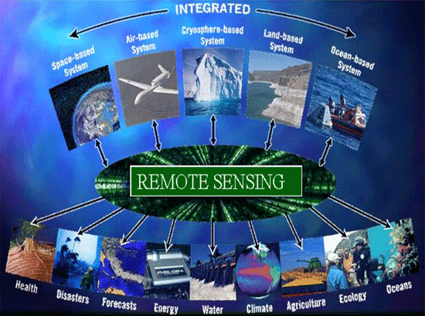
Cloud Storage Systems
Large-scale data processing
Scalability, availability, performance, security
Notes:
Remote sensing data set
Financial engineering

Slide 4
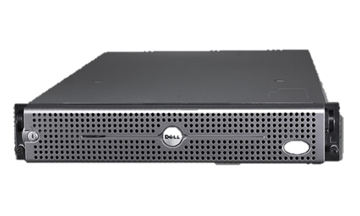
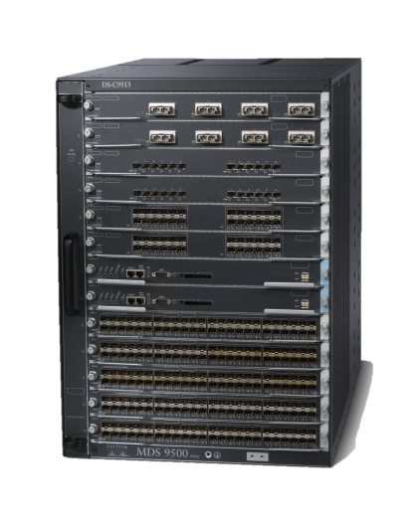
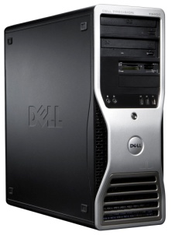
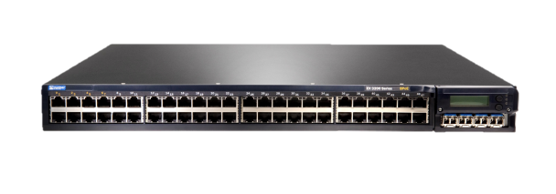
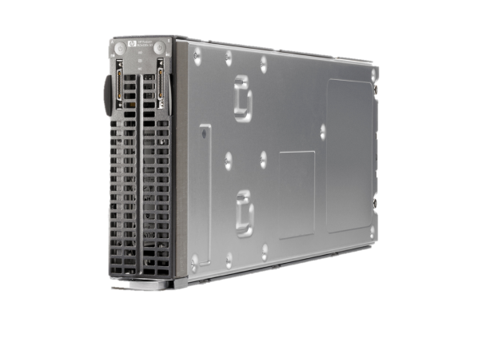
Cloud Storage-A distributed Cluster System
The Architecture of a Cluster
Storage subsystems
(or Storage Area Network)
Head Node
Internet
Client
Network switch
Computing nodes
Notes:
1. A cluster storage subsystem consists of a number of storage nodes
and a gateway. Storage nodes are divided into different server-type groups,
each of which represents a level of security vulnerability.

Slide 5
Heterogeneities in Large-Scale Distributed systems
A wide variety of:
Hardware (e.g., SSDs, HDDs, Tapes)
Software (e.g, HDFS, Lustre, PVFS)
Heterogeneities affect performance
Can we leverage heterogeneity features to improve security for distributed systems?
Notes:
: a secure fragmentation allocation scheme

Slide 6



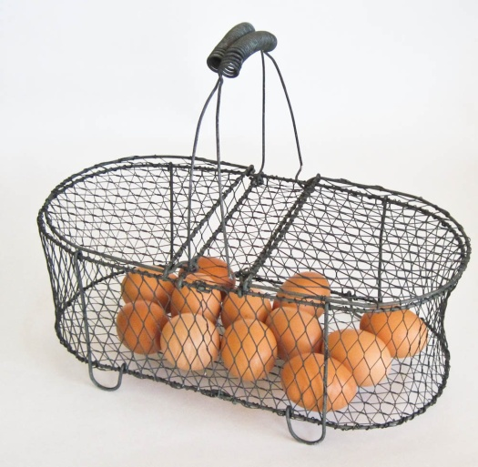
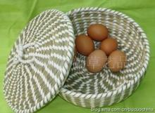
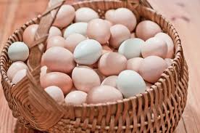
Motivation : Heterogeneity
Heterogeneity Influence on Storage Assurance
Do (Not) Put Our Eggs into One Basket
8/6/2015
Notes:
Warren Buffett --Put all your eggs in one basket, and then watch it
Different storage nodes have different features, there are always tradeoffs among the different choices

Slide 7
Multiple server-type groups
Diversity make sense?
A team with diversity make creativity
A system with diversity may improve security
Classify storage nodes of a system into different “server types” based on their different security level or strategy

Slide 8
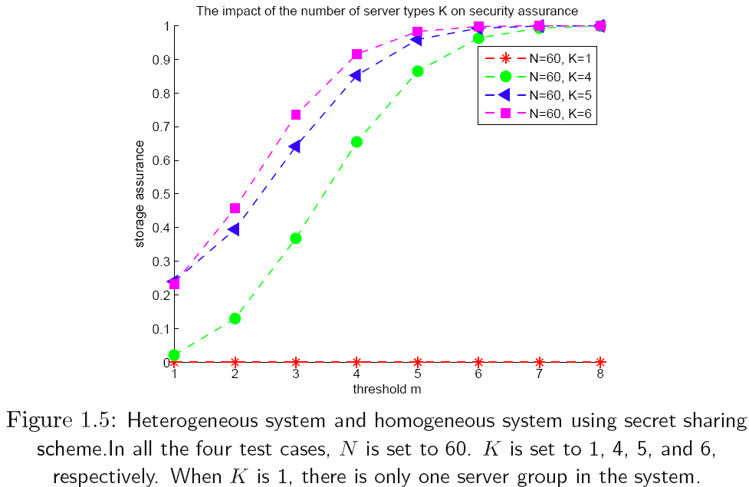
Heterogeneity Impact in S-FAS(NAS ’11)

Slide 9
Heterogeneity Is Valuable
Data Replication to Improve Reliability
Reliability is highly Desired
Data Replication to enhance reliability
There may be two cases
Case 1: Each file fragment has the same number t of
replicas.
Case 2: File fragments have various number (i.e., t1, t2, ... , tx) copies of replicas.
Notes:
cases, where the fragments of files are duplicated. Security and Performance are among the top few features we care a lot, unfortunately there is always tradeoff between these two features.

Slide 10
Heterogeneity Is Valuable
Top Desired Properties: Security, Performance and Reliability
Diversity—Positive or Negative?
Diversity in a Team
A team with diversity is more creative
Make Good Use of Heterogeneous Feature in Storage Nodes to Improve
Performance– a lot of work done
Security– very little done
Reliability– very little done
P
R
R
S
Notes:
---
Security and Performance are among the top few features we care a lot, unfortunately there is always tradeoff between these two features.

Slide 11
Objective
A storage solution for heterogeneous cloud storage
with data replication
considering security and performance.

Slide 12

Fragmentation & Secret Sharing
(m, n) Secret sharing - e.g., (2, 3)
File Fragmentation
Motivation: Storage nodes in a distributed system have heterogeneous vulnerabilities.
Notes:
Shamir proposed the (m, n) secret sharing scheme that
divides data D into n pieces in such a way that D can be
easily reconstructed from any m pieces. If fewer than m pieces
are disclosed, no one can reconstruct D the revealed pieces.

Slide 13
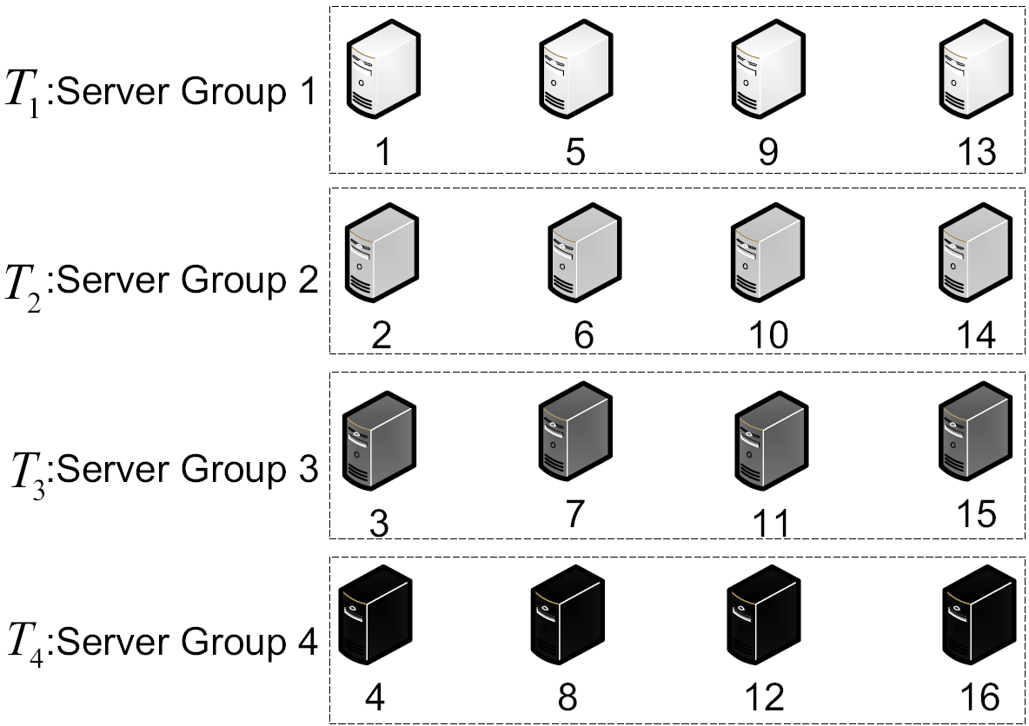
Considering Heterogeneity Issues
File F has 3 fragments:
a, b, c
Fragment a
Fragment b
Fragment c
F(i)= j mod n
Notes:
Fig. 3 A distributed storage system contains 16 storage nodes, which are
divided into 4 server-type groups (or server groups for short), i.e., T1, T2, T3,
and T4. Servers in each group have the same level of security vulnerability.

Slide 14
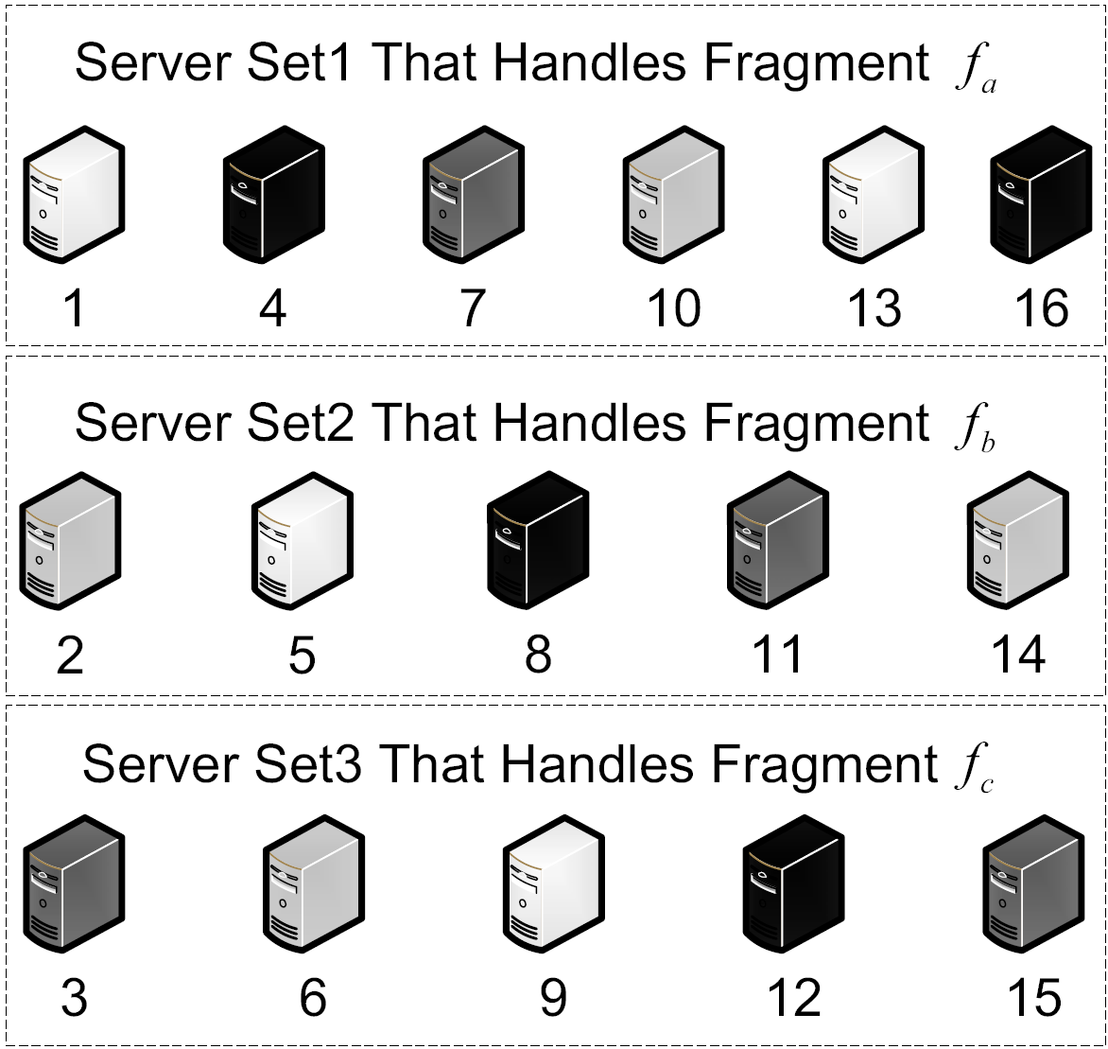

File Fragment Allocations Issues
Problem?
Reconstruct
Fragment a
Fragment b
Fragment c
File F
☹
Notes:
Possible insecure file fragment allocation decision made using a
hashing function (see Eq. 11 in [1]): Server set 1 handles fragment fa, server
set 2 handles fragment fb, and server set 3 handles fragment fc. Server set
1 contains storage nodes r1, r4, r7, r10, r13, and r16; server set 2 contains
storage nodes r2, r5, r8, r11, and r14; and server set 3 contains storage
nodes r3, r6, r9, r12, and r15. It is possible that fragments fa, fb, and fc
may be allocated to storage nodes that belong to the same server-type group.
For example, the three fragments are respectively stored on nodes r4, r8, and
r12, which share the same vulnerability in server group T4. Rather than three
attacks, one successful attack against server group T4 allows unauthorized
users to access the three fragments of file F.

Slide 15
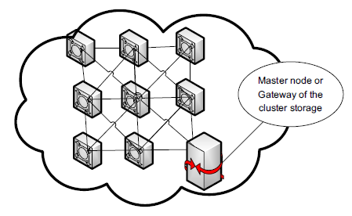
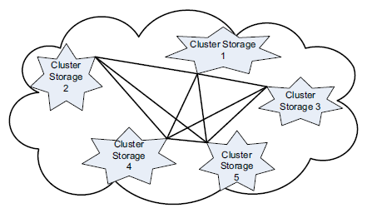
SecRA System Model
Notes:
1. A cluster storage subsystem consists of a number of storage nodes
and a gateway. Storage nodes are divided into different server-type groups,
each of which represents a level of security vulnerability.

Slide 16
SecRA--Outlines
Data Replication
To improve
Assurance, Reliability
and Performance
Fragmentation
Heterogeneous Natures
Secret sharing scheme(m n)

Slide 17
SecRA--Security
Classify storage nodes into multiple server-type groups
Fragments of a file are assigned to storage nodes from as many different server-type groups as possible.
Replicas of the same fragment are assigned to nodes of the same server-type

Slide 18
SecRA--Performance
Assigns at least one complete replica set of a file to a subsystem that is close to clients.

Slide 19
A Case Study for SecRA
Store fragments of a file
across more server-type groups
Store replicas of a fragment
across less server-type groups

Slide 20
Assurance Model for SecRA
Multiplication Principle
Conditional Probability
Combinatorics

Slide 21
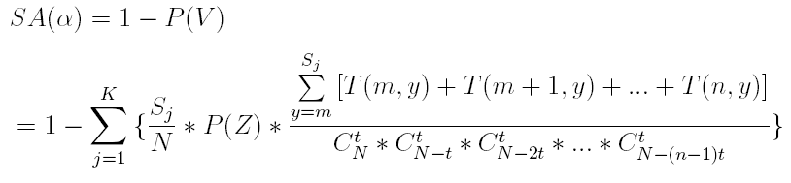
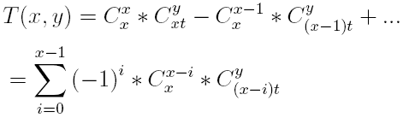
Assurance Model for SecRA
Static Assurance

Slide 22
Design of Evaluation Experiments
Replication Degree
System Size
Number of Fragments of a File

Slide 23
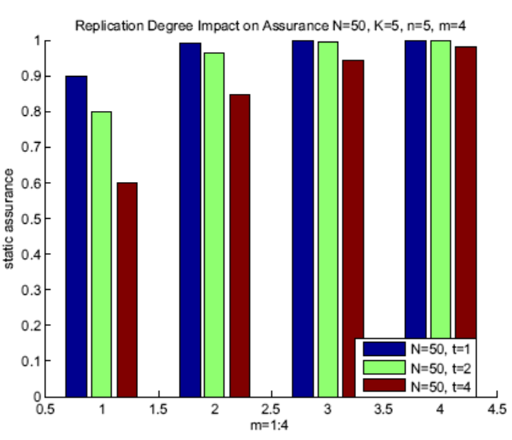
Preliminary Results(1)

Slide 24
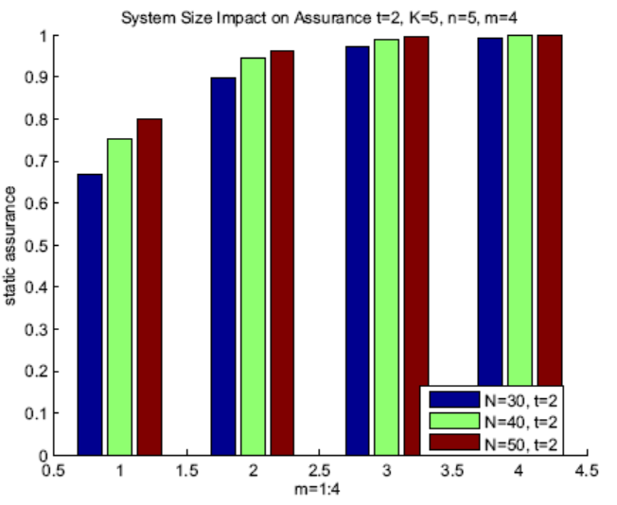
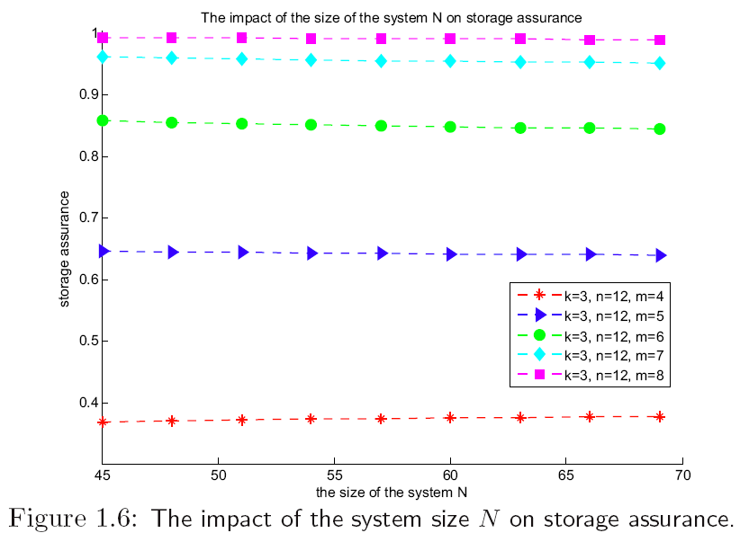
Preliminary Results(2)

Slide 25
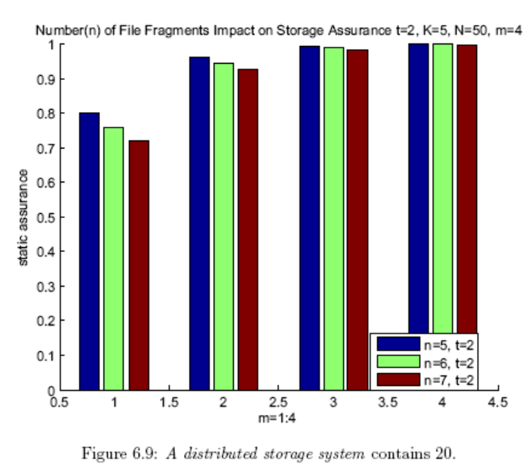
Preliminary Results(3)

Slide 26
Future Work
Dynamic replica reallocation scheme
Implement the scheme in a cloud storage system
Evaluate SecRa by real world trace

Slide 27
Summary
Introduction
Background
SecRA– A Secure Replica Allocation Scheme
Storage Assurance Model
Evaluation Results
Future Work

Slide 28
Thank you!

Slide 29

Suggestions & Questions?

